Slide 1
HTML5 and CSS (Reference)
CSCI 3230U -Web Application Development
Walid M. Ibrahim
Walid.Ibrahim@ontariotechu.net

Slide 2
Outline
Hypertext Markup Language (HTML)
Cascading Stylesheets (CSS)
Styling
Layout
Document Object Model (DOM)
Responsive User Interfaces
2

Slide 3
Hypertext Markup Language (HTML)

Slide 4
Hypertext Markup Language (HTML)
Stores the document/data
Should not contain any styling

Slide 5
HTML - An Example
<!DOCTYPE html>
<html lang="en">
<head>
<meta charset="utf-8">
<title>Document Title</title>
<link rel="stylesheet" href="styles/main.css" />
<script type="javascript" src="js/main.js"></script>
</head>
<body>
<h1>Heading</h1>
<p>This is a paragraph of text.</p>
</body>
</html>

Slide 6
Document Object Model (DOM)

Slide 7
Document Object Model (DOM)
Generated by the browser when parsing the HTML and CSS
Hierarchical (tree-shaped) data structure
The in-memory version of the document

Slide 8
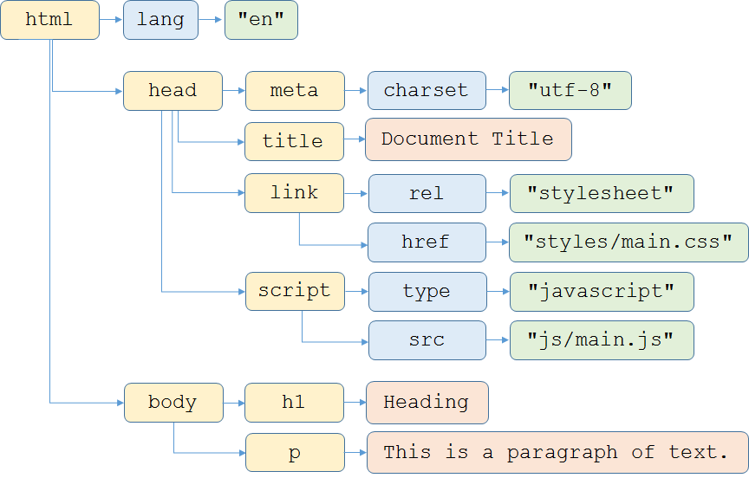
DOM - An Example

Slide 9
Responsive User Interfaces

Slide 10
Responsive User Interfaces
Viewports
Defines the default viewing area (and zoom level)
A common mistake is to just zoom out to show the entire web page
Zoomed 100%, setting page width to device's width:
<meta name="viewport"
content="width=device-width, initial-scale=1" />

Slide 11
Responsive User Interfaces
Does the same set and style of UI elements make sense on all screen sizes?
Television
Desktop/laptop
Tablet
Phone
Media queries to the rescue!

Slide 12
Responsive UI - An Example
<link rel="stylesheet"
href="styles/main.css"
type="text/css" />
<link rel="stylesheet"
href="styles/tablet.css"
type="text/css"
media="screen and (min-width: 701px) and (max-width: 800px)" />
<link rel="stylesheet"
href="styles/phone.css"
type="text/css"
media="screen and (max-width: 700px)" />

Slide 13
Cascading Stylesheets (CSS)

Slide 14
Cascading Stylesheets (CSS)
Determines how the browser will render the HTML
A series of rules
Purpose:
Styling
Layout

Slide 15
Cascading Stylesheets (CSS)
.logoText {
font-family: 'Caveat', 'Arial', sansserif;
}
body {
padding-top: 50px;
font-family: Montserrat;
}

Slide 16
Wrap-up
Hypertext Markup Language (HTML)
Document Object Model (DOM)
Responsive User Interfaces
Cascading Stylesheets (CSS)
Styling
Layout

Slide 17
Helpful Links
https://html.com/
https://www.w3schools.com/html/
https://www.tutorialspoint.com/html/index.htm
https://developer.mozilla.org/en-US/docs/Web/HTML
https://www.w3schools.com/css/
https://www.tutorialspoint.com/css/index.htm
https://developer.mozilla.org/en-US/docs/Learn/CSS

